Slide 1
Crime Data Analysis for Baltimore, MD
Analyzing crime by neighborhood in Baltimore, MD

Slide 2
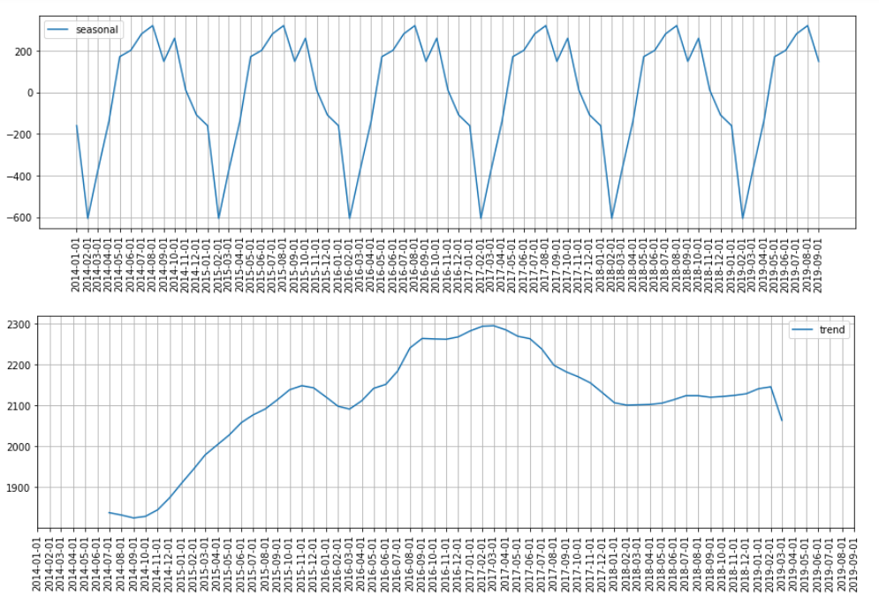
Overall Trends for the Entire City

Slide 3
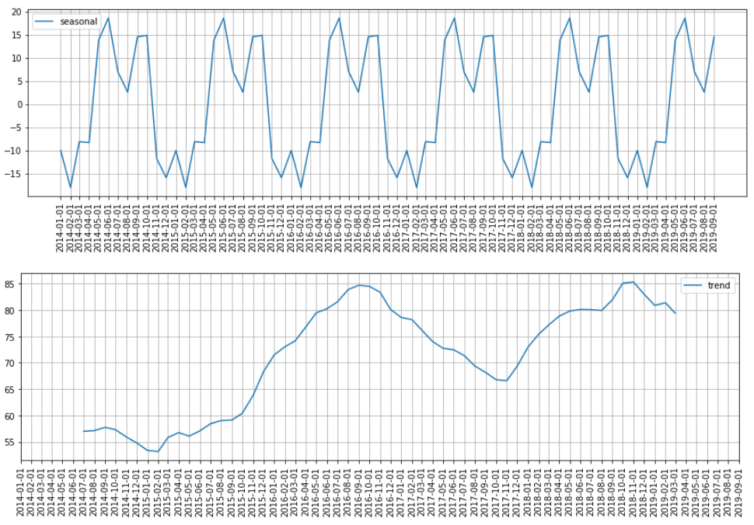
Trends for the Highest Crime Area

Slide 4
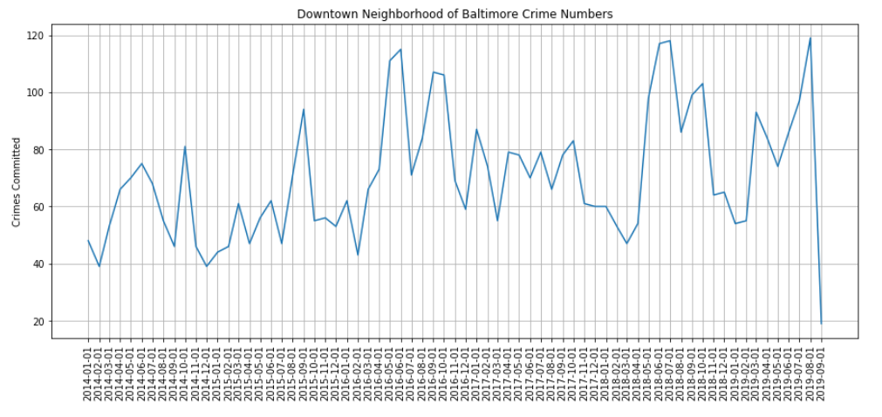
Downtown Neighborhood Crime

Slide 5
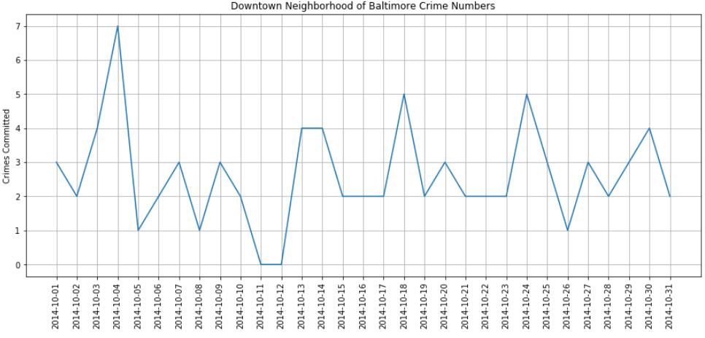
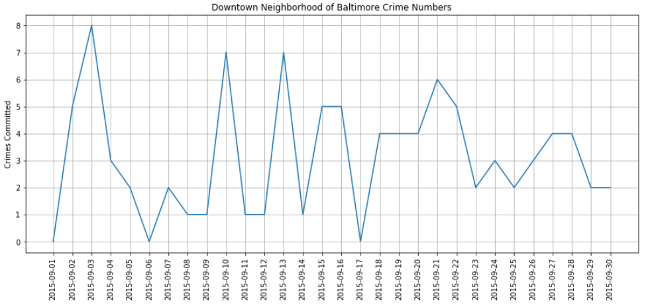
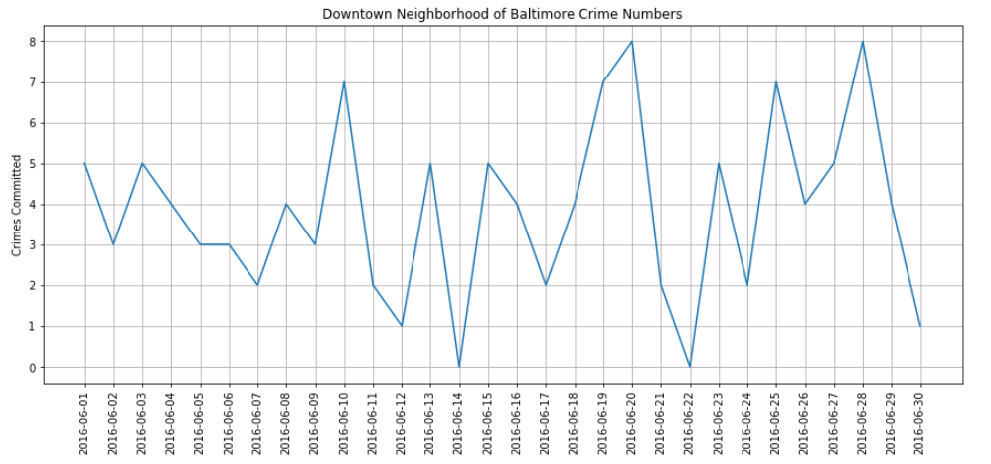
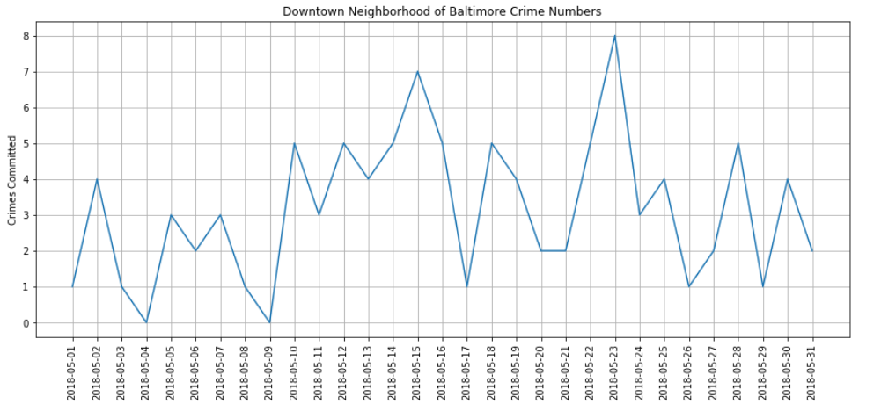
Multiple Months with Spikes
10/2014
9/2015
6/2016
5/2018

Slide 6
Conclusion
With the data I had or was able to look up and find, I was unable to predict the area or time a crime would occur.
Further Work
Get more and better data to work with
Predict where and when the most amount of crimes will occur, so law enforcement can be deployed to deter crime

Slide 7
Thank you for taking the time to join me. Levi Raichik ☺

